Slide 1
CASE # 1
THE SHOE STORE

Slide 2
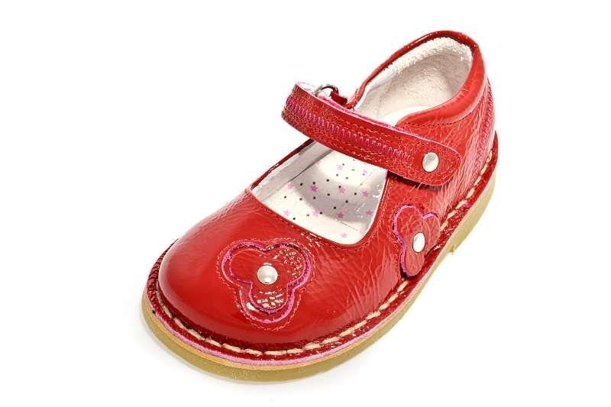
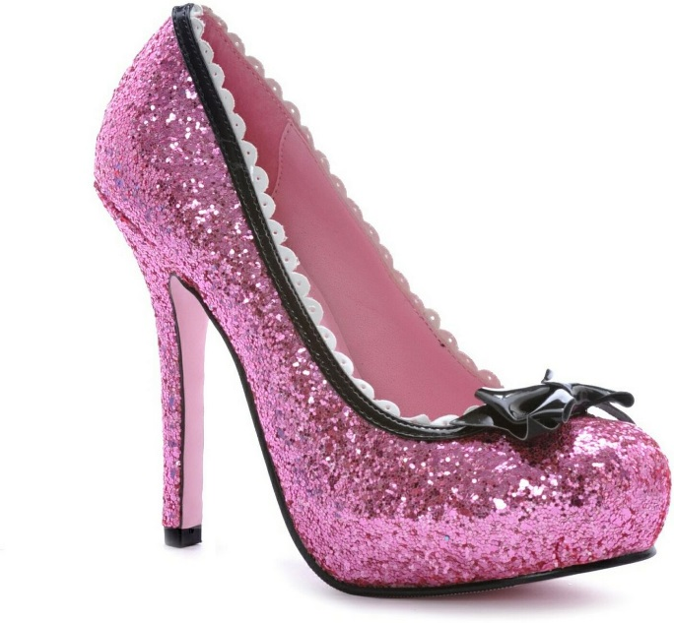
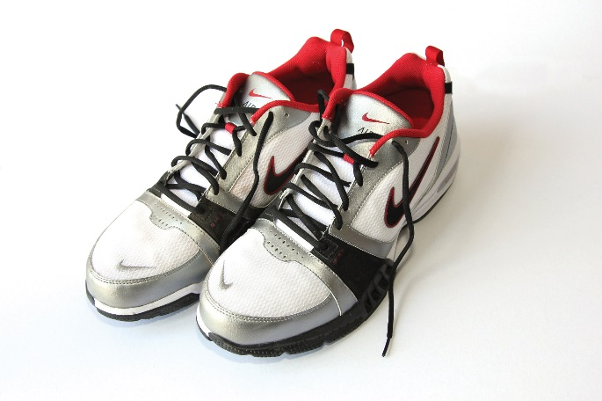
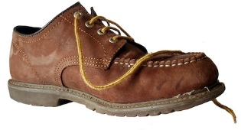
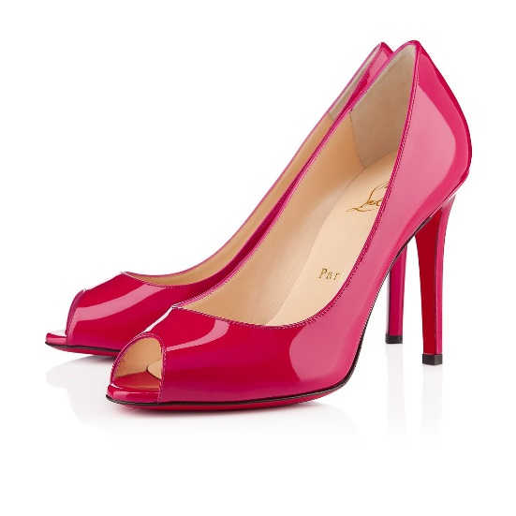
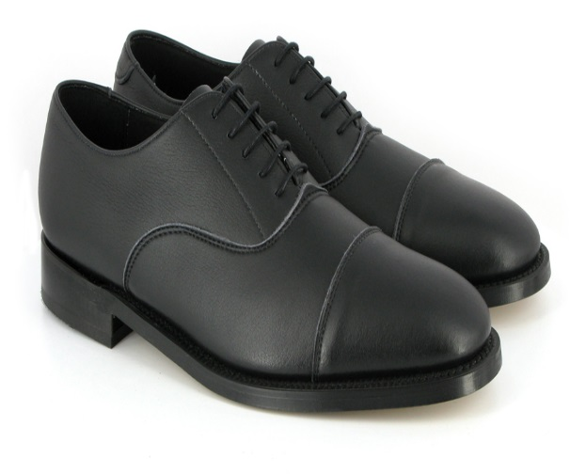
THE ASK:
WHAT SEGMENT SHOULD WE ATTACK?
Why?
Through What Vehicle(s)?
With What Discount Rate?
DESIGN A TEST AND LEARN PLAN
CREATE CATEGORY MANAGEMENT STRATEGY

